Slide 1
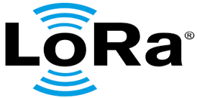

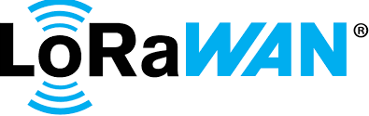
LPWAN TECHNOLOGIES
Sagar Suresh Chavan
Embedded System Design Team
CDAC, Hyderabad

Slide 2

Agenda
What is LPWAN? and Where does LPWAN fit?
Important factors in LPWAN
Introduction to LoRa and LoRaWAN
Overview of LoRaWAN Network Architecture
LoRaWAN device classes
Configuration of LoRa and LoRaWAN
End device Joining procedure in LoRaWAN
ADR in LoRaWAN and important terms in LoRa/LoRaWAN
Overview of Data Flow and Data frame format
Introduction to NB-IoT
Features of NB-IoT
Conclusion

Slide 3
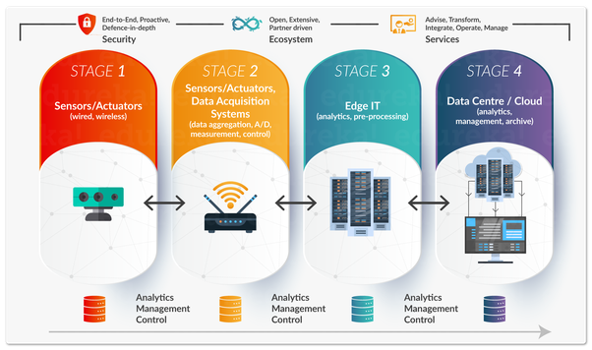
IoT Architecture

Slide 4
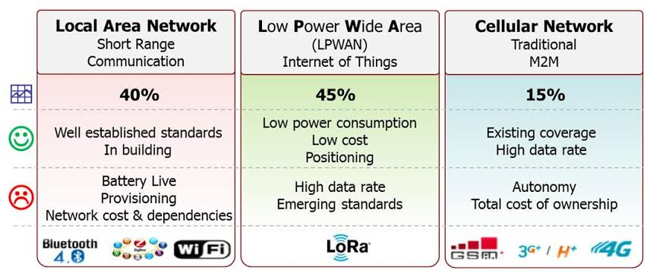
WHERE DOES LPWAN FIT?
One technology cannot serve all the projected applications in IoT.
WiFi and BTLE are widely adopted standards and serve the applications related to communicating personal devices quite well.
Cellular technology is a great fit for applications that need high data throughput and have a power source.
LPWAN offers multi-year battery lifetime and is designed for sensors and applications that need to send small amounts of data over long distances a few times per hour from varying environments.

Slide 5
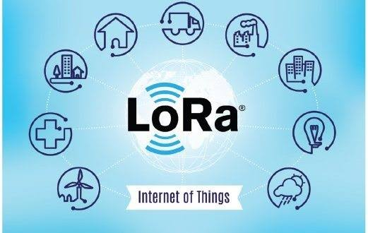
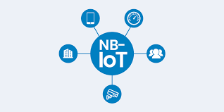
Important factors in LPWAN
The most critical factors in a LPWAN are:
Network architecture
Communication range
Battery lifetime or low power
Robustness to interference
Network capacity (Max. Number of nodes in a network)
Network security

Slide 6
What is LoRa ?
LoRa (short for long range) is a spread spectrum modulation technique derived from chirp spread spectrum (CSS) technology.
LoRa technology is a wireless platform invented by Semtech mainly for IoT applications including long range, low power consumption and secure data transmission.
The wireless radio frequency technology(LoRa Tech.) enables smart IoT application that solve some of the biggest challenges facing our planet.
Semtech LoRa technology has to be used in smart cities, smart home & buildings, smart agriculture, smart metering, smart supply chain and logistics, and many more.In simple words ==> LoRa connects devices(all things) to cloud.
The technology can utilized by public, private or hybrid n/w’s and provides greater range than cellular networks.

Slide 7
Why LoRa ?
LoRa technology uses ISM frequency band.
Long range up to ~10km.
Low power consumption so that system can runs up to ~few years with battery.
Low bandwidth.
Secure data transmission, uses end-to-end AES128 encryption, mutual authentication, integrity protection and confidentiality.
Mobile : maintains communication with devices in motion without strain on power consumption.
Low cost of deployment.

Slide 8
LoRaWAN
The LoRaWAN open specification is a low power, wide area networking (LPWAN) protocol based on LoRa technology.
Designed to wirelessly connect battery operated things to the Internet in network. The LoRaWAN protocol uses the unlicensed radio spectrum in industrial, Scientific and Medical(ISM) band.
The LoRa specifications defines the device -to- infrastructure of LoRa physical parameters and the LoRaWAN protocol.
LoRaWAN uses the Star-of-star topology between the sensor node and the network server.
In a LoRaWAN network nodes are not associated with specific gateway. Instead, data transmitted by a node is typically received by multiple gateway.
Each gateway will forward the received packet from the end-node to the cloud-based network server via some backhaul (either cellular, Ethernet, satellite, or Wi-Fi).
The intelligence and complexity is pushed to the network server, which manages the network and will filter redundant received packets

Slide 9
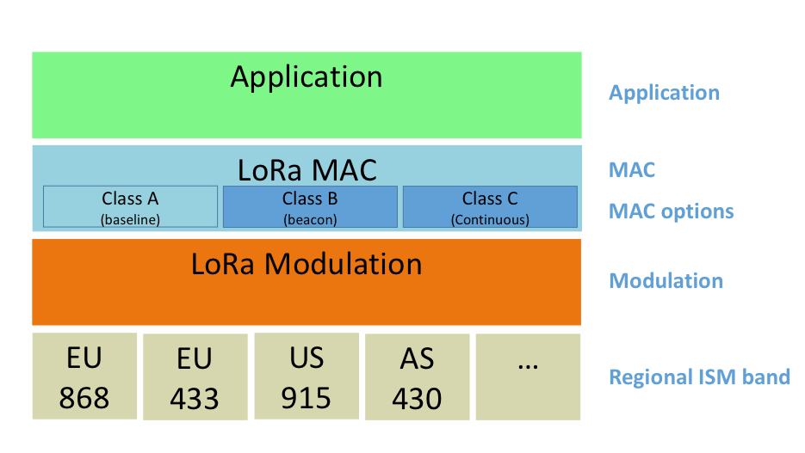
LoRaWAN (cont..)
LoRaWAN™ defines the communication protocol and system architecture for the network while the LoRa® physical layer enables the long-range communication link.
The protocol and network architecture have the most influence in determining the battery lifetime of a node, the network capacity, the quality of service, the security and the variety of applications served by the network.
Fig: LoRaWAN communication protocol stack

Slide 10
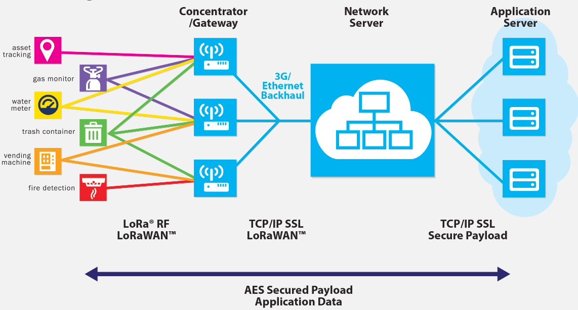
LoRaWAN Architecture

Slide 11
LoRaWAN Device Classes
Bi-directional end device(Class A) :
End devices of class A allow for bi-directional communication whereby each end device’s uplink transmission is followed by two short downlink receive windows.
The transmission slot scheduled by end device and uses ALOHA type protocol.
This class A operation is used by the lowest power end device which requires the downlink data immediately after the uplink frame.
UL | DL1 | DL2 | UL | DL1 | DL2
Frame-1
Frame-2

Slide 12
LoRaWAN Device Classes
Bi-directional end device with scheduled receive slots(Class B) :
End devices of class B allow for more receive slots it opens some additional receive windows at scheduled times.
The end device receives time synchronized beacons from gateway in order to open the extra receive windows.
Bi-directional end device with maximal receive slots(Class C) :
Class C end devices offers the nearly continuous open receive windows, only closed when transmitting.
It provides lowest latency than other two classes.
Class C devices requires more power to operate than class A and B, generally they are mains powered.
UL | DL1 | DL2 | EX
UL | Continuous DL

Slide 13
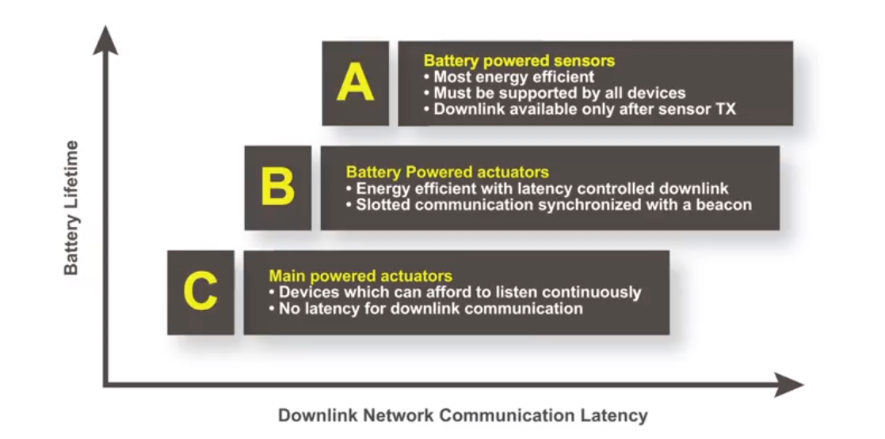
Comparison of device classes

Slide 14
LoRa configuration parameters
To set the LoRa communication we have to configure parameters as follows:
Modulation technique: LoRa (chirp spread spectrum (CSS))
RF Frequency band: Regional band i.e. IND 865-867 MHz
Transmission output power(dBm) : From 14-20 dBm
Bandwidth: There are three different bandwidth for LoRa that are 125 KHz, 250 KHz and 500 KHz.
Spreading factor (SF): It is simply the duration of the chirp. LoRa operates with spread factors from 7 to 12. Each step up in spreading factor doubles the time on air to transmit the same amount of data.
Coding rate (CR): It refers to the proportion of the transmitted bits that actually carries information. LoRa allowed coding rates CR= 4/5, 4/6, 4/7 or 4/8.
Preamble length: LoRa introduces a preamble of a few symbols(typically eight).
Payload length: amount of data to be send (Fixed or variable)
CRC: Cyclic Redundancy Check(CRC) field is only present in uplink transmission.

Slide 15
End Device Joining
To participate in a LoRaWAN network, each end device has to be personalized and activated, activation of an end device can be achieved in two ways, either via Over-The-Air Activation(OTAA) or via Activation By Personalization(ABP).
Over-The-Air Activation (OTAA) :
For over-the-air activation, end-devices must follow a join procedure prior to participating in data exchanges with the network server.
The join procedure requires the end-device to be personalized with the following information before it starts the join procedure: a globally unique end-device identifier (DevEUI), the application identifier (AppEUI), and an AES-128 key (AppKey).
The join procedure consists of two MAC (media access control) messages exchanged with the server, namely a join request and a join accept.
The end-device sends the join-request message consisting of AppEUI and DevEUI of the end-device followed by the DevNonce.
The network server will respond to the join-request message with a join-accept message if the end-device is permitted to join a network.
After activation, the following information is stored in the end-device: a device address (DevAddr), an application identifier (AppEUI), a network session key (NwkSKey), and an application session key (AppSKey).
If above all steps are successful then OTAA is accomplished

Slide 16
End Device Joining (cont..)
Activation By Personalisation (ABP) :
The end devices can be activated by personalization.
ABP directly ties an end-device to a specific network, by-passing the join request – join accept procedure.
So, the DevAddr and the two session keys NwkSKey and AppSKey are directly stored into the end-device instead of the DevEUI, AppEUI and the AppKey.
Simply, the end-device is already equipped with the required information for participating in a specific LoRa network when started.
The advantage of ABP is that it is easy to connect to the network because the device can be made operational in little time, which is very suitable for certain applications.

Slide 17
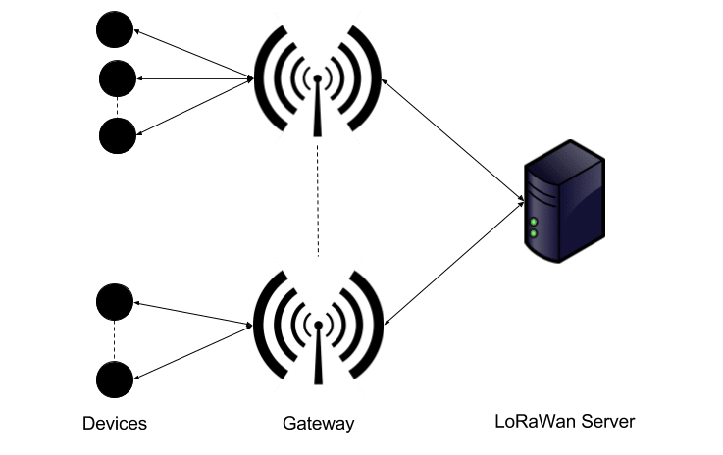
Adaptive data rate
A key feature of LoRaWAN infrastructure is the ability to scale the data rate as needed to achieve the best data rate.
Maintains the good signal strength(which also save the power at the end node).
Adaptive Data Rate is meant for stationary node only.
Refer following figure, showing that end nodes are stable and sending data packets to gateway.

Slide 18
Terms in LoRaWAN
Data rate: LoRaWAN network stack rooted in the LoRa physical layer. It features a maximum data rate of 27 kbps.
Duty Cycle: LoRaWAN specifies that each a message is send in one ISM sub-band, the device must wait the remaining time of the duty cycle in that band before resending. In most regions this duty cycle is set to 1%.
Time on Air(ToA): When a signal is send from end node it takes a certain amount of time before a receiver receives this signal. This time is called Time on Air(ToA). It varies upon others parameters like SF, Tx power, CR.

Slide 19
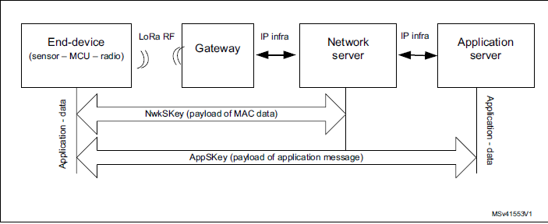
Data Flow in LoRaWAN

Slide 20

Data Frame format

Slide 21
Introduction to NB-IoT
Narrowband Internet of Things(NB-IoT) is a Low Power Wide Area Network(LPWAN) radio technology standard developed by 3GPP
NB-IoT enables the wide range of cellular devices and services.
NB-IoT focuses specifically on indoor coverage, low cost, long battery life and high connection density.
It uses a subset of the LTE standard, but limits the bandwidth to a single narrow-band of 200kHz.
It uses OFDM modulation for downlink & SC-FDMA for uplink communication.
IoT applications which requires more frequent communication will be better served by NB-IoT.
It doesn’t have any duty cycle limitations operating on the licensed spectrum

Slide 22
Features of NB-IoT
Low device cost - Less than $5 per module
Extended coverage - 164dB MCL, 20dB better compared to GPRS
Long battery life - >10 years
Capacity - ~55K devices per cell
Uplink latency - <10 seconds

Slide 23
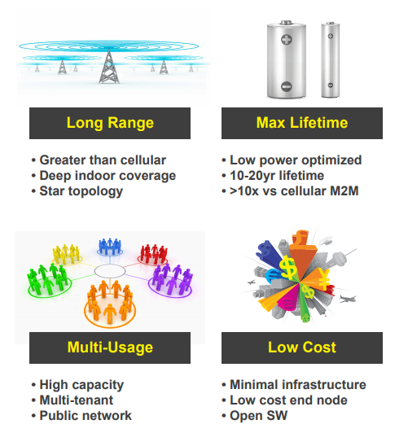
Conclusion

Slide 24
Thank you..!!

